Slide 1
Exploring the impact of environmental triggers on epithelial barrier dysfunction: initiation of a complex inflammatory cascade
Associate Professor Asger Sverrild, MD, PhD
Copenhagen University Hospital Bispebjerg, Copenhagen, Denmark

Slide 2
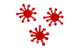


Asthma can be triggered by a variety of environmental exposures¹
Self-reported asthma triggers by proportion of patients
experiencing trigger and frequency of trigger^{1,2a}
Frequency of triggers
(weeks/year)
Allergic trigger
Non-allergic trigger
Frequency of trigger
A higher number of known asthma triggers correlates with an increased number of severe exacerbations¹
52% of participants self-reported exposure to 6–15 asthma triggers^{1b}
One in five patients do not attempt to avoid known asthma triggers until symptoms worsen¹
A burden of ≥11 triggers is associated with an adverse impact on daily life¹
Proportion of patients who experienced the trigger (%)
Self-reported asthma triggers (N=1,202)
Top 15 triggers by proportion of patients experiencing given trigger
ªFigure adapted from Price D et al. J Asthma. 2014;51(2):127–35 licensed under CC-BY 4.0 from: http://creativecommons.org/licenses/by/3.0 (Accessed February 2026); ^{b}13% of patients reported 1–5 asthma triggers,
and 35% reported ≥16.¹
References: 1. Price D, et al. J Asthma. 2014;51(2):127–35; 2. Gautier C, Charpin D. J Asthma Allergy. 2017;10:47–56.

Slide 3
COPD triggers have been reported, including known allergens^{1a}
Triggers observed in a study of patients in Singapore with COPD¹
(N=129)
Proportion of patients with COPD with:¹
≥1 trigger:
43%
≥2 triggers:
18%
≥3 triggers:
12%
.
Abbreviations: COPD, chronic obstructive pulmonary disease; RTI, respiratory tract infection.
Reference: 1. See KC, et al. Singapore Med J. 2016;57(10):561–65.

Slide 4
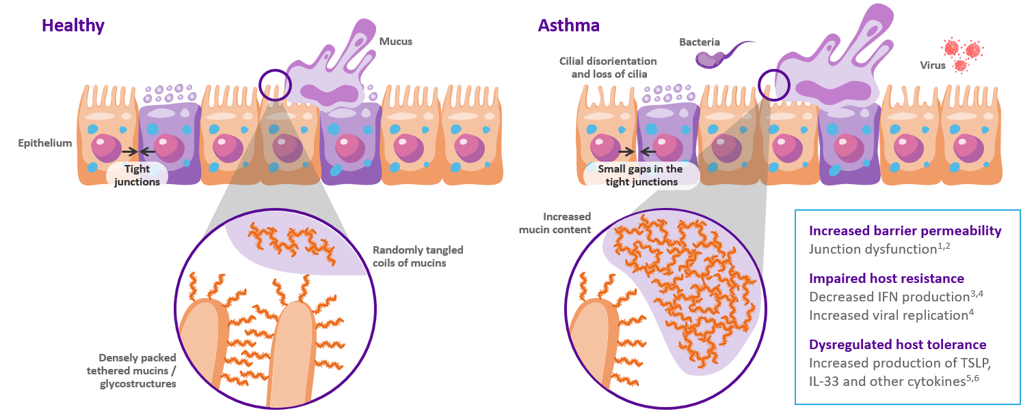
The airway epithelium: barrier and immune mediator
Healthy
Asthma and COPD
Mucus
Bacteria
Cilial disorientation and loss of cilia
Virus
Epithelium
Tight
junctions
Small gaps in tight junctions
Increased mucin content
Increased barrier permeability
Junction dysfunction^{1,2}
Impaired host resistance
Decreased IFN production^{3,4}
Increased viral replication⁴
Dysregulated host tolerance
Increased production of TSLP, IL-33, and other cytokines^{5–7}
Randomly tangled coils of mucins
Densely packed tethered mucins / glycostructures
Figure adapted from Frey A, et al. Front Immunol. 2020;11:761
Abbreviations: COPD, chronic obstructive pulmonary disease; IFN, interferon; IL, interleukin.
References: 1. Looi K, et al. Exp Lung Res. 2016;42:380–95; 2. Saatian B, et al. Tissue Barriers. 2013;1:e24333; 3. Contoli M, et al. Nat Med. 2006;12:1023–26; 4. Wark PA, et al. J Exp Med. 2005;201:937–47; 5. Uller L, et al. Thorax. 2010;65:626–32; 6. Porsbjerg C, et al. Eur Respir J. 2022;60:2102333, 7. Calvén J, et al. J Innate Immun. 2012;4(1):86–99.

Slide 5
Admission due to COPD exacerbations significantly decreased during the COVID-19 pandemic¹
18,000
16,000
14,000
12,000
10,000
Number of admissions for COPD exacerbations
Mild to moderate
8,000
Severe
6,000
4,000
Linear regression
models
2,000
0
Jul
Jan
Jul
Jan
Jul
Jan
Jul
Jan
Jul
Jan
Jul
Jan
Jul
Jan
Jul
Jan
Jul
Jan
Jul
Jan
Jul
Jan
Jul
2012
2013
2014
2015
2016
2017
2018
2019
2020
2021
2022
2023
Figure adapted from Bourdin A, et al. JAMA Netw Open. 2024 May 1;7(5):e2412383.
Abbreviations: COPD, chronic obstructive pulmonary disease; COVID, coronavirus disease.
Reference: 1. Bourdin A, et al. JAMA Netw Open. 2024 May 1;7(5):e2412383.

Slide 6
Substantial reductions in asthma exacerbations were seen over the course of the COVID-19 pandemic¹
Change in asthma exacerbation rate during the COVID-19 pandemic compared with pre-pandemic (n=100,632)¹
ªMean of 2016–2019¹
Abbreviations: COVID, coronavirus disease; Q, quarter.
Reference: 1. Shah SA, et al. Thorax. 2021;76(9):860-866.

Slide 7






Triggers play a key role as drivers of inflammation^{1–6}
Triggers interact directly with the epithelium to initiate the inflammatory cascade^{1–6}
  The types of triggers can lead the release of different cytokines by the epithelium and the subsequent activation of different cell types^{1–6}
  The response to triggers can differ between airway disease, as well as within disease type^{1–6}
In airway diseases triggers are factors that lead to symptoms of disease^{7,8}
Avoidance of triggers is seen as a preventative measure in airway disease management^{7,9}
Examples of airway disease triggers:^{7–10}
Cigarette smoke
Pollution
Fungi
Bacteria
Allergens
Viruses
References: 1. Gauvreau GM, et al. Expert Opin Ther Targets. 2020;24(8):777–92; 2. Calderon AA, et al. Eur Respir Rev. 2023;32(167):220144; 3. Brightling C, Greening N. Eur Respir J. 2019;54(2):1900651; 4. Fokkens WJ, et al. Rhinol. 2020;58(Suppl.S29):1–464; 5. Victor AR, et al. J Immunol. 2017;199(7):2333–42; 6. Staudacher AG, et al. Ann Allergy Asthma Immunol. 2020;124(4):318–25; 7. Aydin Ö, et al. Allergol Immunopathol (Madr). 2013;41(1):30–6; 8. Wedzicha JA, Seemungal TA. Lancet. 2007;370(9589):786–96; 3. 9. See KC, et al. Singapore Med J. 2016;57(10):561–65; 10. Connell D, Shah A. Eur Respir J. 2020;56(2):2002223.

Slide 8



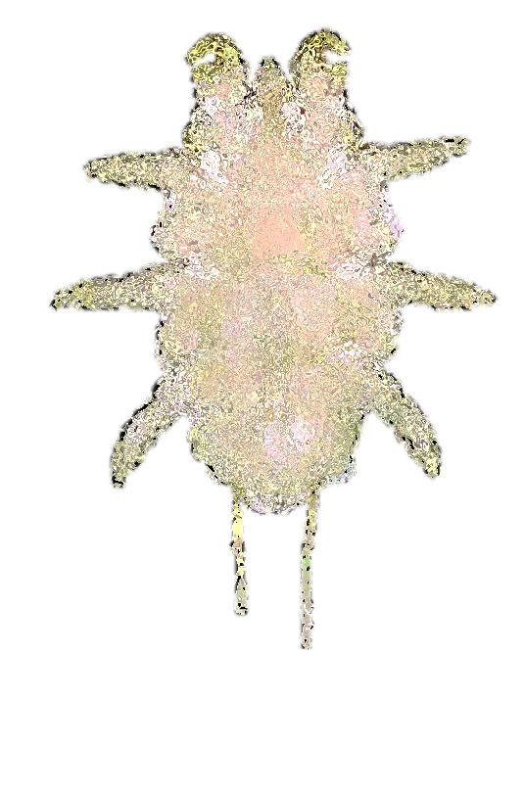
Epithelial cytokines may play a key role in driving airway inflammation in patients with asthma
Viruses, allergens,
cigarette smoke and pollution
Alarmins
IL-33, TSLP, IL-25¹
T2 interleukins
IL-4¹
IL-13¹
IL-5¹
Biomarkers
IgE/EOS¹
FeNO¹
EOS¹
Airway hyper-responsiveness¹
Mucus plugging^{2–4}
Airway hyper-responsiveness¹
Mucus secretion¹
Airway remodelling¹
Bronchoconstriction¹
Airway remodelling¹
Mucus plugging^{3–5}
Pathophysiological outcomes
Clinical outcomes
Symptoms,^{1–3,5} lung function decreases,¹ exacerbations¹
Abbreviations: EOS, eosinophil; FeNO, fractional exhaled nitric oxide; IgE, immunoglobulin E; IL, interleukin; T2, Type 2; TSLP, thymic stromal lymphopoietin.
References: 1. Porsbjerg CM, et al. Eur Respir J. 2020;56(5):2000260; 2. Cohn L, et al. J Exp Med. 1997;186(10):1737-47; 3. Lambrecht BN, et al. Immunity. 2019;50(4):975–91; 4. Kim Y, Yoo KH. Allergy Asthma Immunol Res. 2022;14(2):151-152; 5. Dunican EM, et al. J Clin Invest. 2018;128(3): 997–1009.
8

Slide 9
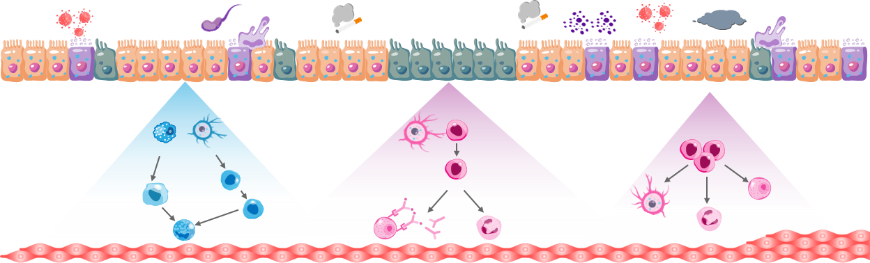
In COPD, triggers can act through multiple inflammatory pathways to contribute to disease pathology^{1,2a}
Triggers
Viruses
Bacteria
Smoke
Allergens
Pollution
Epithelium
Mucus
TSLP
IL-33
TSLP
IL-33
TSLP
IL-33
IL-25
Goblet cell
Macrophage
Dendritic cell
Naïve
T cell
Dendritic cell
Naïve
T cell
ILC2s
IL-4
IL-5
IL-13
IL-13
IL-4
IL-13
Th2 cell
IL-5
Leucocytes
Airway smooth muscle
Th17
Eosinophil
Mast cell
IL-17A
Mast cell
IgE
Dendritic cell
Neutrophil
Eosinophil
Type 1/3
Type 2
ªPlease note that the proposed inflammatory pathways in COPD shown here have been simplified for illustration purposes only and do not align with specific disease pathology or clinical manifestations, nor do they imply clinical benefit or relevance. In COPD, environmental triggers can cause damage to the epithelium, resulting in cellular inflammation and alarmin release.^{1,2} Several different inflammatory pathways, including those involved in Type 1, Type 3 and Type 2 inflammation, are thought to contribute to the heterogeneous disease pathology and clinical manifestations in COPD.^{3–8} Following damage to the epithelium, epithelial alarmins TSLP, IL-33 and IL-25 are released, promoting downstream inflammation.^{1,2} Both TSLP and IL-33 can contribute to Type 2 and non-Type 2 pathways in COPD^{1,2}
Figure adapted from Calderon AA, et al. Eur Respir Rev. 2023;32(167):220144 and Brightling C, Greening N. Eur Respir J. 2019;54(2):1900651.
Abbreviations: COPD, chronic obstructive pulmonary disease; IgE, immunoglobulin E; IL, interleukin; ILC, innate lymphoid cell; Th, T helper; TSLP, thymic stromal lymphopoietin.
References: 1. Calderon AA, et al. Eur Respir Rev. 2023;32(167):220144; 2. Brightling C, Greening N. Eur Respir J. 2019;54(2):1900651; 3. MacNee W. Proc Am Thorac Soc. 2005;2(4):258–266; 4. Paliogiannis P, et al. Eur Respir Rev. 2018;27(147):170113; 5. Rabe KF, et al. Am J Respir Crit Care Med. 2023;208(4):395–405; 6. Safiri S, et al. BMJ. 2022;378:e069679; 7. Keddache S, et al. Clin Immunol. 2021;229:108798; 8. Global Initiative for Chronic Obstructive Lung Disease (GOLD). Global strategy for the diagnosis, management, and prevention of chronic obstructive pulmonary disease report. 2025. Available from: https://goldcopd.org/wp-content/uploads/2024/11/GOLD-2025-Report-v1.0-15Nov2024_WMV.pdf (Accessed February 2026).

